Slide 1
Data Analysis Life Cycle
Edem And Franklin

Slide 2
Data Analysis Life Cycle

Slide 3
Introduction
Data science is an interdisciplinary academic field that uses statistics, scientific computing, scientific methods, processes, algorithms and systems to extract knowledge and insights from potentially noisy, structured, or unstructured data. Basically data science is all about making meaning out of data.
Data analysis focuses on extracting insights and drawing conclusions from structured data, while data science involves a more comprehensive approach that combines statistical analysis, computational methods, and machine learning to extract insights, build predictive models, and drive data-driven decision-making.
In the data analysis process, there are six phases to go through to get the desired result. These are ASK, PREPARE, PROCESS, ANALYZE, SHARE, AND ACT.

Slide 4
ASK
The question to be asked must be SMART, which means Specific, Measurable, Action-oriented, Relevant and Time bound.
These were some of the SMART questions concept being asked:
What do customers buy more at the shop?
What period do customers buy those goods and why?
Will prices of these goods affect their purchases?
Do these customers have other substitutes?
PREPARE
Preparing your data means collecting or using the data relevant to the problem you are trying to solve.

Slide 5
The following aspects should be considered:
What metrics to measure? (Metrics are quantitative measurements). To answer these questions, there might be a need to also answer sub-questions (e.g., is our time-to-market competitive for product X? If not, what process improvements would help?).
What factors should be considered?
Where the data is located (files, database, external system, internal system)?
If the data will be moved, how it will be stored and what are the needed security measures to protect that data.
Questions to ask you in this step:
What needs to be figured out how to solve this problem?
What would help to measure the outcome of any change to the problematic area?
What research is needed?
Where is the information held?

Slide 6
DATA FROM BOATENG & SONS ENTERPRISE, DECEMBER 2023
ITEMS | PRICES(GHS) | NO. OF ITEMS BOUGHT | SUBSTITUTES
MILO | 50 | 1500 | CHOCOLIM, RICHOCO
NIDO | 45 | 1350 | COWBELL, MIKSI
DIGESTIVE BISCUITS | 25 | 800 | SHE ME MA, PERK
SARDINE(TITUS) | 15 | 500 | LELE,GINO
MILK(IDEAL) | 10 | 2000 | CARNATION, NUNU

Slide 7
PROCESS
Data processing is to find various inaccuracies, errors, inconsistencies in the data and get rid of them so that our primary business problem is not affected. You must clean the data so that the data is consistent and will not affect the credibility of the analysis.
During this step one might:
Using proper tools to find incorrect and incomplete data.
Removing inconsistencies in data. Sometimes there might be duplicated entries.
One of the most important aspects to keep in mind - identifying whether your data is biased. Essentially, data that is biased will not be representative of the population or phenomenon of study, our issue we are trying to solve.
Questions to ask yourself in this step:
Is the data source trustable and data quality high?
What data errors or inaccuracies could occur within a given dataset.
What is the best possible answer to the problem being solved?

Slide 8
ANALYSE
The primary goal in this phase is to find the relationships, trends, and patterns that will help you solve your business problem more accurately.
Next up is to make some conclusions based on the trustable data.
Further processing might include:
Performing different calculations get additional metrics.
Combining additional data attributes from a variety of sources to get a more comprehensive story.
Create different views for the data. Like tables with your results, filter and pivot them.
Make it visual if possible! Charts tell more than a thousand words.
Questions to ask yourself in this step:
What story is my data telling me?
Why can’t it be done?
Will X (e.g. time, money, manpower or expertise) allow us to solve the issue?
How will my data help me solve this problem?
Who needs my company’s product or service?
What type of person is most likely to use it?

Slide 9
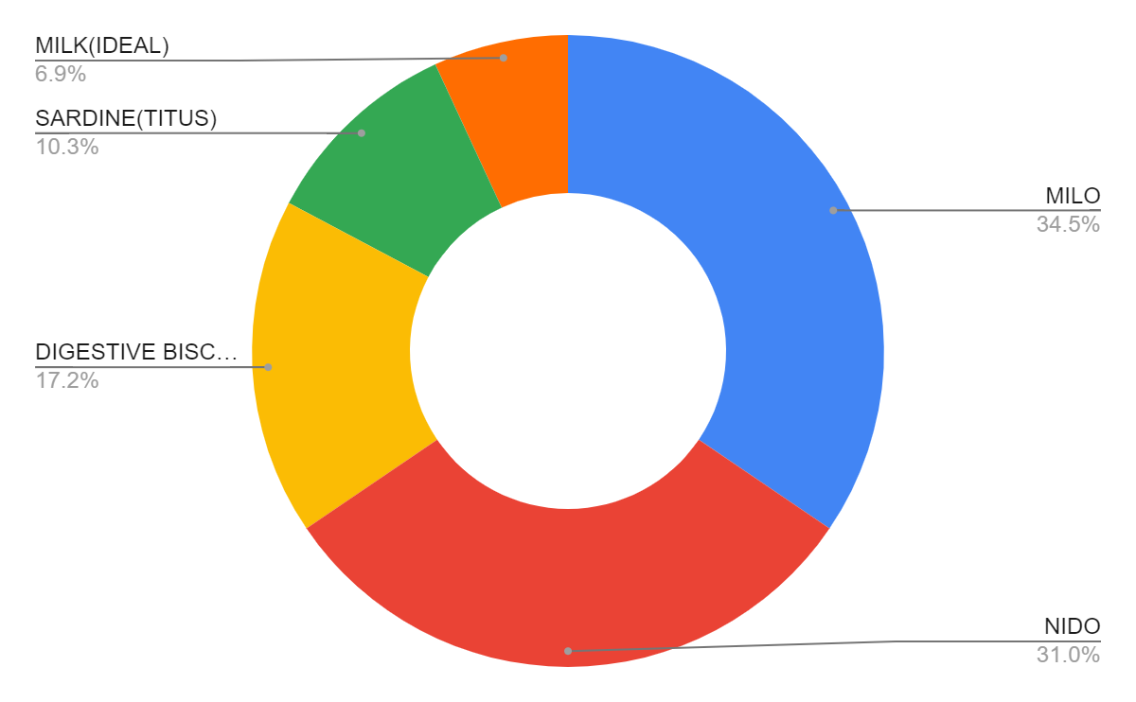
Chart A

Slide 10
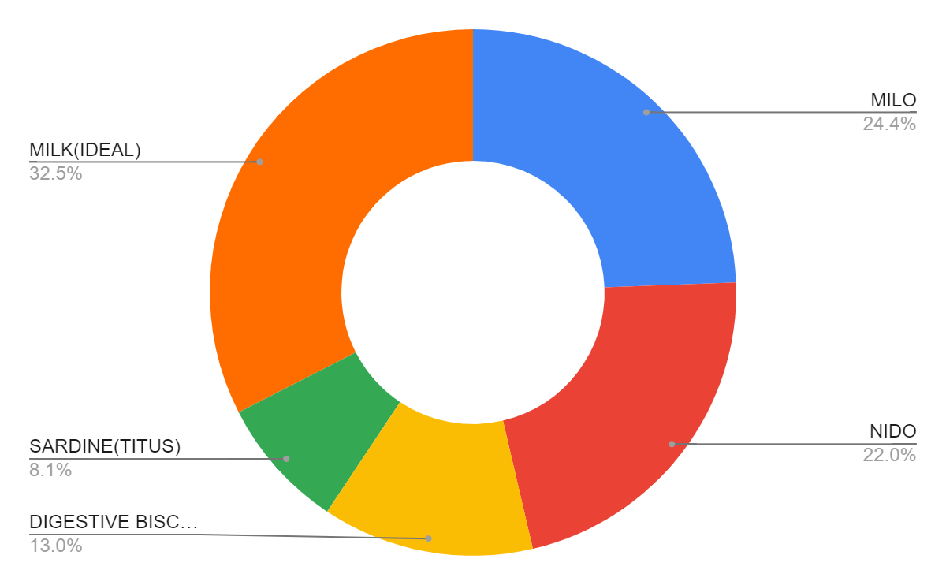
Chart B

Slide 11
SHARE
This phase is about getting additional opinions about the findings. This will significantly help to improve the results and ensure that main aspects were taken into account.
Sharing will certainly help with:
Making better decisions: The feedback will help to answer the questions that initially were not thought of.
Making more informed decisions: Feedback will not be merely critical, but also suggestions and additional information on the matter.
Improve the general outcome: From one angle, the decision will most likely be more informed and better, but also the transparency will grant that there is more support to the findings.
Questions to ask yourself in this step:
How can I make what I present to the stakeholders engaging and easy to understand?
What would help me understand this if I were the listener?
What makes data visualization good?

Slide 12
ACT
we will use everything we have learned from our analysis and act upon it. You will provide recommendations to the stakeholder on how to solve the business problem and help them make a good decision.
Questions to ask yourself in this step:
How can the feedback received during the sharing phase (step 5) be used to meet the stakeholder’s needs and expectations?
What potential solutions to the outlined problem could there be?
Is this problem worth solving? (Yes, that is also a potential outcome)

Slide 13
Conclusion
Ask: Business Challenge/Objective/Question
Prepare: Data generation, collection, storage, and data management
Process: Data cleaning/data integrity
Analyze: Data exploration, visualization, and analysis
Share: Communicating and interpreting results
Act: Putting your insights to work to solve the problem

